Slide 1

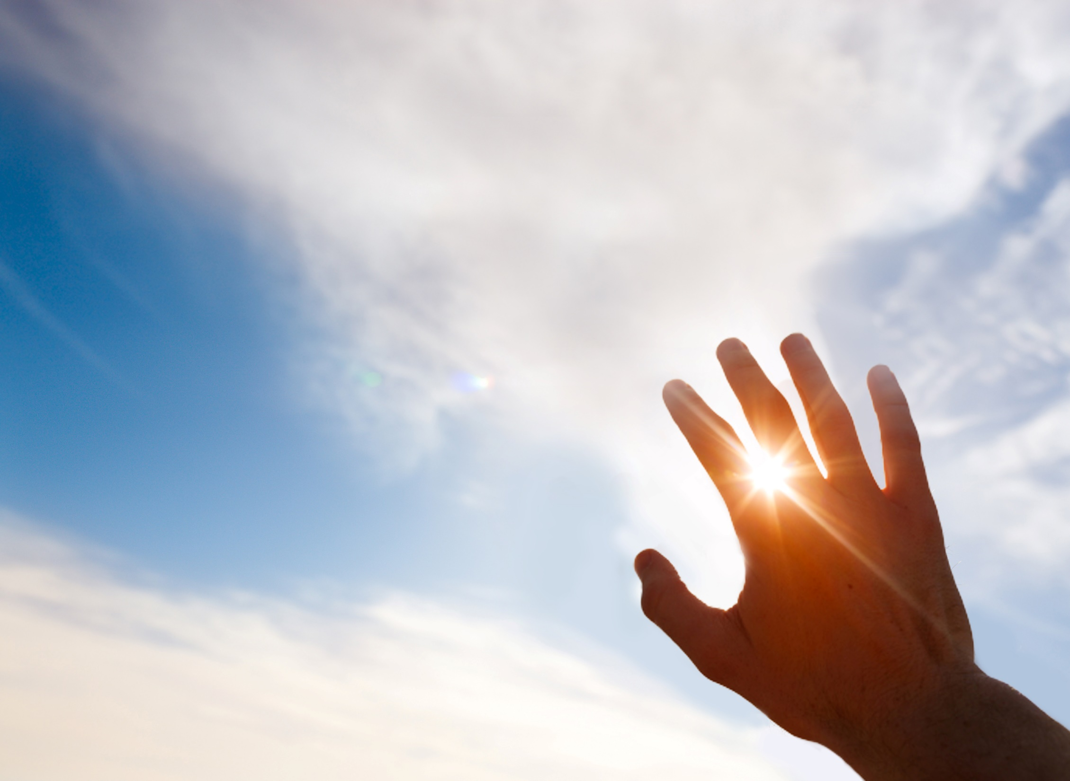




Unit 7
Like the Sun

Slide 2
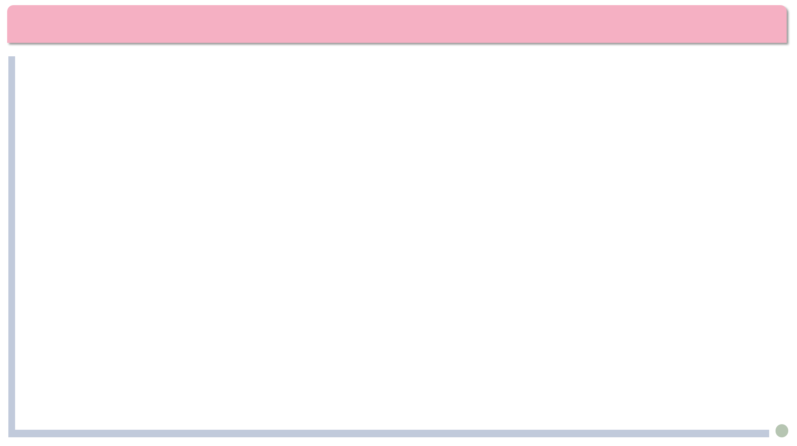


Lead-in
The Most Popular White Lies We Tell or Hear Every Day:
Thank you for your gift. I love it so much!
Yeah, you look great in that dress.
Your baby is adorable!
The food will be served in 5 minutes.
I’m five minutes away.
I’m fine.
I would never lie to you.
I’m 29.

Slide 3

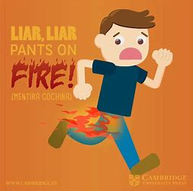
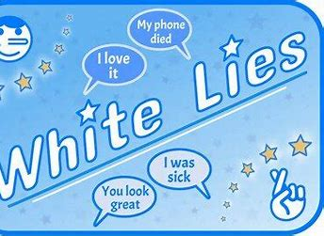
主观题
20分
Share with us a lie you recently told or heard.
作答

Slide 4
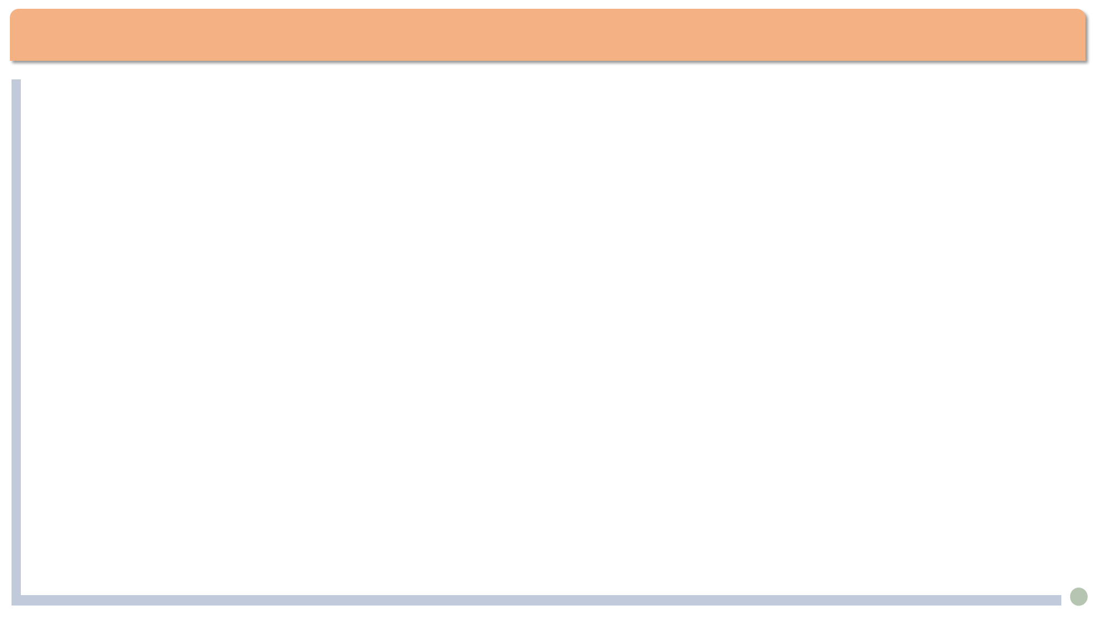
Background
The author of the text
R.K. Narayan(纳拉扬) (1906-2001)
one of the best-known and widely read Indian writers.
His style is marked by warm humor, gentle irony, and simplicity.
The text "Like the Sun" is taken from his Under the Banyan Tree and Other Stories, published in 1985.

Slide 5
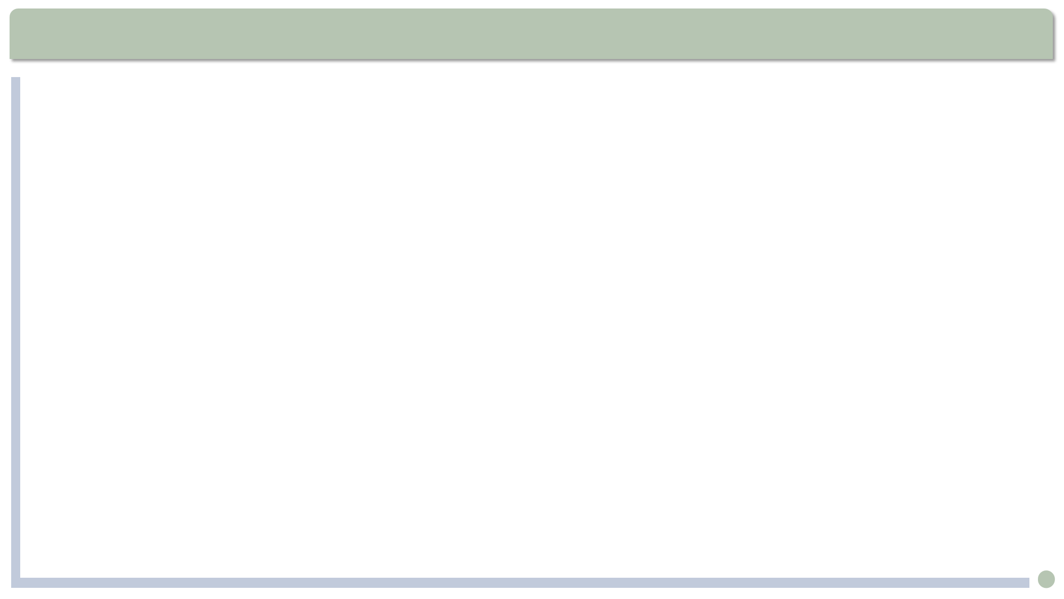
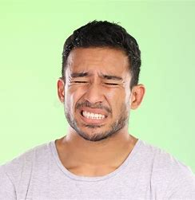
Text Analysis
But Sekhar cut him short: “Far from it. He always struck me as mean and selfish.”
cut ... short: interrupt
The chairman will cut a speaker short if he talks too long.
strike sb. as: give sb. a particular impression 给人……印象；让人觉得
1. 他给我的印象很浪漫。
He strikes me as romantic.
2. His reaction struck me as odd.
他的反应令我诧异。
3. Lucy strikes me as a very silly girl.
wince

Slide 6
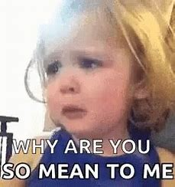
填空题
20分
Sekhar’s experiment: to give and take [填空1] Truth.
Test 1:
When his wife brought him his breakfast with a titbit she considered her [填空2](代表作) but he always disliked, he told her the truth, and saw his wife [填空3] (皱眉).
Test 2：
When his colleague expressed sadness over the death of a person whom the colleague thought was a fine man, Sekhar told him that he thought the man was [填空4] (刻薄) and selfish.
作答

Slide 7
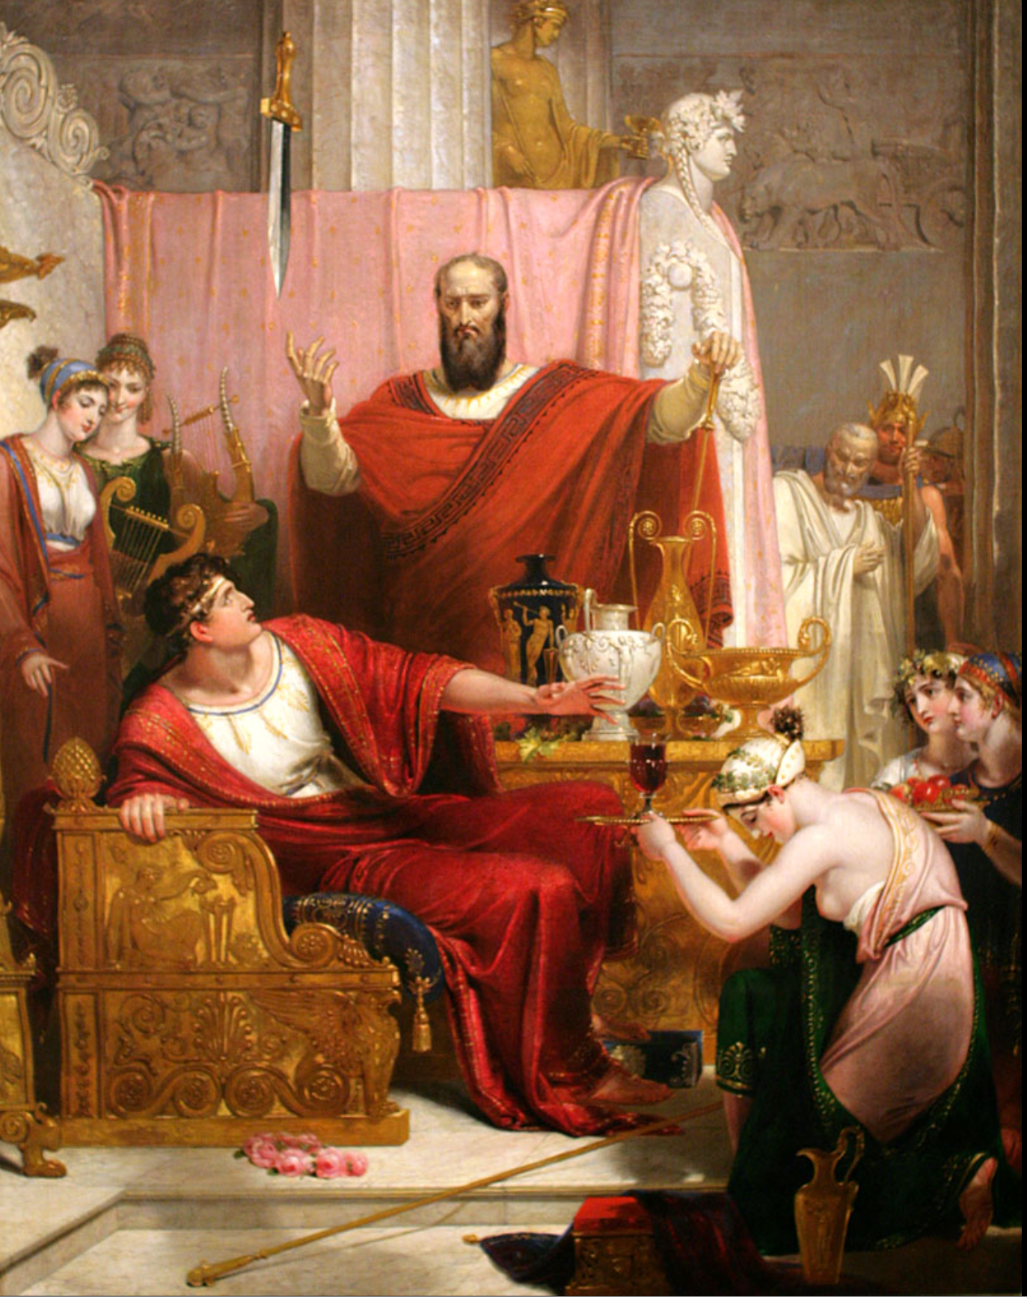
Text Analysis
He had kept putting the work off for weeks, feeling all the time as if a sword were hanging over his head.
他还没开始批改，已经拖了好几个星期了，这些考卷就好像一把达摩克利斯剑一直悬在头上。
Here the “sword” refers to the “sword of Damocles,” which means something bad and threatening that may happen at any time.(allusion典故)

Slide 8
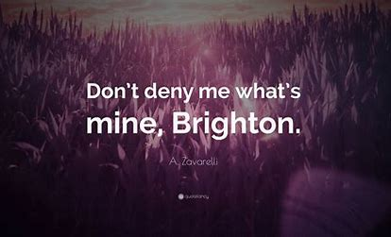
Text Analysis
God hasn’t given me a child, but at least let him not deny me the consolation of music, ...
deny sb. sth. : (formal) refuse to allow sb. to have sth. that they want or ask for 不给；拒绝给与；不允许有；剥夺
We denied him access to the information.
我们不允许他获取该信息。
Nobody should be denied the right to education.
没有人应该被剥夺受教育的权利。
He denied her girlfriend nothing.
他对女朋友百依百顺。

Slide 9
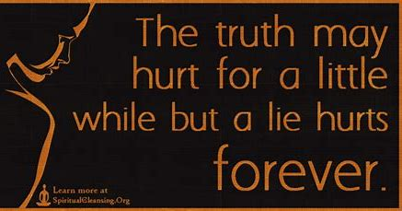
单选题
10分
Which translation of underlined words is correct according to the text?
A
my weakness for music --- 弱点
B
I’ve engaged a drummer --- 雇佣
C
deny me the consolation --- 否认
D
a violinist to accompany me --- 陪伴
提交

Slide 10
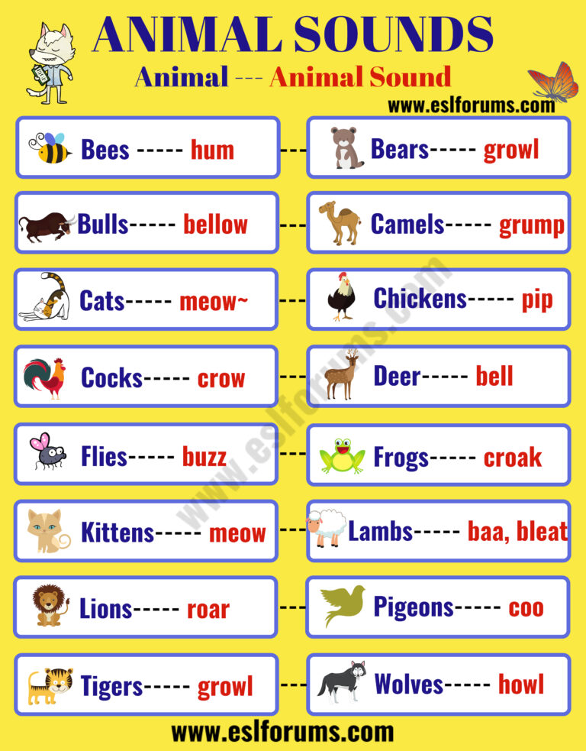
填空题
10分
Fill in the blanks with the sounds of these animals. Choose from the words given below.
Frogs [填空1].
Buffaloes [填空2].
Monkeys [填空3].
quack, bellow, croak, chatter, meow
作答

Slide 11
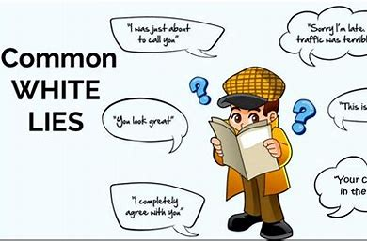
Text Analysis
The incense sticks burnt low.
“Low” here is an adjective used as a subject complement.（形容词做主语补语）
1. The poor girl was born blind.
2. It is a pity that he died young.
3. 我站在那儿目瞪口呆。
I stood there stunned /stupefied/ dumbfounded.
4. 他被打得青一块紫一块。
He was beaten black and blue.

Slide 12
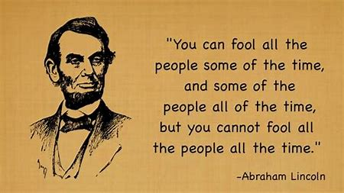
填空题
20分
Chinese to English translation: 1. 满面汗珠: be [填空1] with perspiration 2. 一帆风顺: be [填空2] sailing 3. 宣布审判结果：to deliver a [填空3] 4. 他犹豫不定地问道: He asked [填空4].
5. 说得再委婉一些：speak more [填空5]
作答

Slide 13
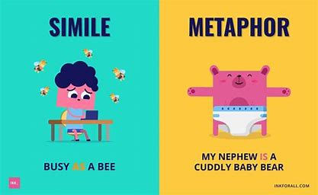
填空题
20分
What rhetorical devices(修辞手段) are applied in the sentences below?
1. Now he sounds like loose window shutters in a storm. [填空1]
2. Two casualties for today. [填空2]
3. ... as if a sword were hanging over his head. [填空3]
4. No judge delivering a sentence felt more pained and helpless. [填空4]
a. simile(明喻) b. metaphor(暗喻) c. hyperbole(夸张) d. allusion(典故)
作答

Slide 14
Speaking
Share with us
1. A lie you told which was necessary.
2. A true word which hurt you or someone else.
3. Do you agree with the author’s saying: Truth is like the sun?

Slide 15
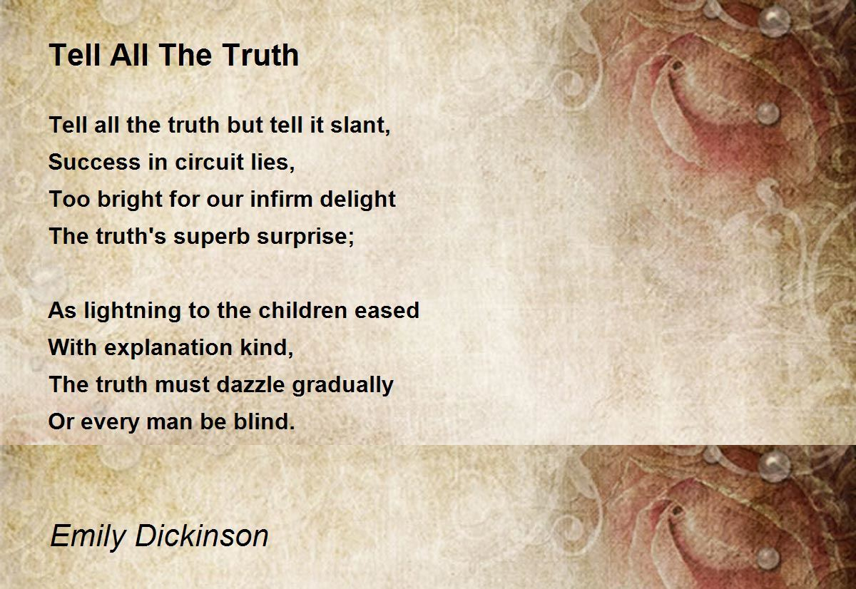
Poem
要说出全部真相，但切莫直言——
迂回之路方能取胜
真相的惊喜太炫目
对于我们脆弱的欢喜而言，过于明亮
如缓解孩子对闪电的惊恐
需要我们慈爱的解释，
真相必须逐渐散发它的光芒，
否则每一个人都会失明。

